Slide 1


WingMate – AI Study Buddy for AFCAT ✈️
Team Name: Ingenious
Team Leader: Anshul Patel
College: Jai Narain College of Technology
“Discipline, Motivation, and Smart Prep for Future Air Warriors”

Slide 2
Challenges Faced by AFCAT Aspirants
Scattered Study Resources
Lack of Discipline & Consistency
Limited Real-Time Doubt Solving
Aspirants struggle to find consolidated and relevant study materials, leading to disorganization and wasted time.
Maintaining a consistent study routine is challenging without external motivation and tracking, often leading to burnout.
Immediate clarification for complex topics is often unavailable, hindering continuous learning progress.
Poor Time Management
Anxiety & Stress
Many candidates struggle with effective time allocation during the actual exam, impacting their scores despite preparation.
The high-stakes nature of the AFCAT exam often leads to significant mental stress, affecting performance and well-being.

Slide 3

SOLUTION OVERVIEW
Introducing WingMate: Your AI Study Buddy
WingMate: A dedicated AI-powered study platform designed specifically for AFCAT aspirants.
Combines structured academic notes, motivational support, and personalized testing workflows to create a comprehensive learning ecosystem.
Supports aspirants throughout their entire preparation journey, from foundational learning to exam-day readiness.

Slide 4



The Critical Role of Personalised Prep
WingMate directly addresses key challenges faced by AFCAT aspirants, making it an indispensable tool for success.
Consistent & Disciplined Routines
Personalised Guidance & Tracking
Quizzes &
Updated Content
Automates scheduling and progress tracking, fostering habits crucial for long-term preparation success.
Provides tailored learning paths and performance analytics, adapting to individual strengths and weaknesses.
Keeps aspirants engaged with fresh content and consistent encouragement, crucial for sustained effort.

Slide 5





Preliminary Solution Concept: Our Vision
Curated Subject-Wise Notes
Instant Doubt Resolution & Motivation
Daily Quizzes & Performance Tracking
Comprehensive, well-organised study material covering the entire AFCAT syllabus, easily accessible.
AI-powered chatbot provides immediate answers to queries and motivational boosts when needed.
Short, focused daily tests with real-time feedback to reinforce learning and track progress.
Personalised Report Cards
Defense-Related Updates
Detailed analytics highlighting strong and weak areas, guiding aspirants on where to focus their efforts.
Real-time news and current affairs relevant to defense, keeping aspirants informed and exam-ready.

Slide 6
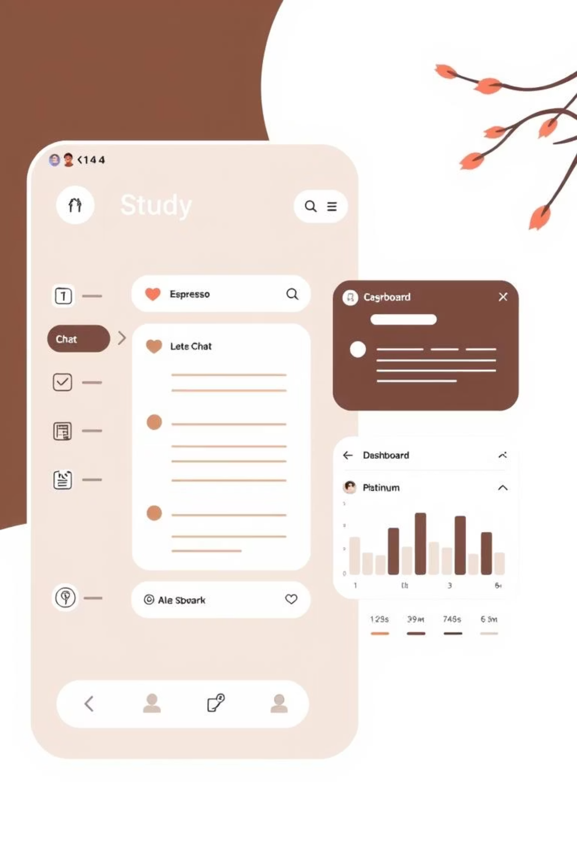
Key Features & Functionalities
📚 Notes Hub: Structured and comprehensive study material.
⚔️ Commanding Officer Mode: Gamified discipline tracking for consistent study.
🤖 Mentor Chat: Instant doubt resolution and motivational support.
📰 Exam-related News Updates: Real-time notifications on relevant news.
📝 Daily Smart Tests & Quizzes: Adaptive questions with instant scoring.
💪 Motivation & Streak Badges: Gamified incentives to maintain engagement and progress.
📊 Performance Dashboard: In-depth analysis of weak/strong areas.

Slide 7




Users & Use Cases: The WingMate Journey
Users: AFCAT aspirants preparing for competitive defense exams, seeking structured and supportive learning.
Quiz & Feedback Loop
Motivation Boost
Student takes quiz → receives instant score, detailed weak area analysis, and personalised remedial material.
Student feels demotivated → Mentor Chat detects mood, sends encouraging messages and success stories.
Discipline Alert
Daily Briefing
Student skips target → Commanding Officer mode sends a gentle reminder and adjusts the study plan.
Student opens app → receives latest defense news, current affairs, and a personalised study plan for the day.

Slide 8

Data & Privacy: Our Commitment
Data Needed
Privacy Measures
Student scores and performance metrics (e.g., accuracy, speed).
Secure Cloud Storage: All data is encrypted and stored on highly secure cloud servers with robust access controls.
Activity logs (e.g., time spent on topics, quiz attempts).
Quiz responses for deeper analysis of learning patterns.
Consent-Based Personalisation: User data is only used for personalisation with explicit consent, ensuring transparency.
Minimal Data Collection: We only collect data essential for improving the learning experience, strictly avoiding unnecessary personal information.
Anonymisation & Aggregation: Data used for analytics and improvements is anonymised where possible and aggregated to protect individual identities.

Slide 9

Smart Work Stack: Tools & Technologies
Frontend / UI
Quizzes & Reports
Backend / Data
Tailwind in CSS
Typeform
Airtable
React
Google Sheets (integration)
Firebase
Figma (for design)
Outgrow
Bubble workflows
Mentor / Chatbot
News & Updates
Analytics / Dashboard
n8n
RSS feeds
Google Data Studio
Voiceflow
Zapier (automation)
Power BI
Built-in platform features
Emphasis: Tools used for smart workflows, personalisation, and automation—minimal coding required for rapid hackathon development.

Slide 10

Implementation & Evaluation: Road to Success
Implementation Strategy (Hackathon Focus)
Build responsive UI/UX using a no-code platform.
Integrate a smart mentor chatbot for instant doubts and motivation.
Develop core quiz functionalities with immediate feedback and performance reports.
Automate defense news updates feed for current affairs.
Set up gamification elements like streak badges and progress tracking.

Slide 11
Evaluation: Road to Success
Key Evaluation Metrics
User Engagement Rate: Daily active users and session duration.
Test Completion Rate: Percentage of daily quizzes completed by users.
Accuracy & Consistency Improvement: Tracking score trends and adherence to study plans.
User Satisfaction Feedback: Surveys and direct testimonials on the platform's utility and impact.
Feature Adoption Rate: Usage statistics for specific features like Mentor Chat and Commanding
Officer Mode.

Slide 12

THANK YOU
We are ready to empower the next generation of AFCAT aspirants.

